Slide 1
SCSA2203
DATA STRUCTURES AND ALGORITHMS
LAB
Program to implement operations on a Singly linked list.

Slide 2
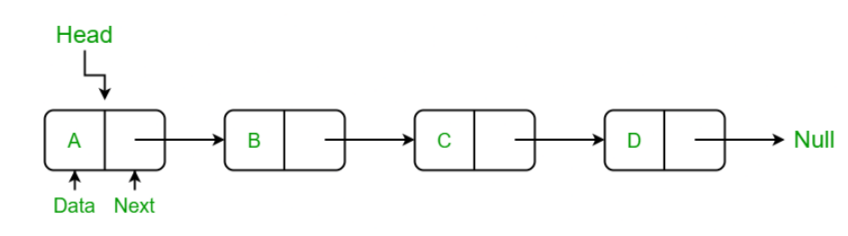
Like arrays, a Linked List is a linear data structure.
Unlike arrays, linked list elements are not stored at a contiguous location; the elements are linked using pointers.
They include a series of connected nodes. Here, each node stores the data and the address of the next node.

Slide 3
Arrays Limitation
Arrays can be used to store linear data of similar types, but arrays have the following limitations:
The size of the arrays is fixed:
Insertion of a new element / Deletion of a existing element in an array of elements is expensive:
Types of Linked Lists:
Simple Linked List – In this type of linked list, one can move or traverse the linked list in only one direction. where the next pointer of each node points to other nodes but the next pointer of the last node points to NULL. It is also called “Singly Linked List”.
Doubly Linked List – In this type of linked list, one can move or traverse the linked list in both directions (Forward and Backward)
Circular Linked List – In this type of linked list, the last node of the linked list contains the link of the first/head node of the linked list in its next pointer.

Slide 4
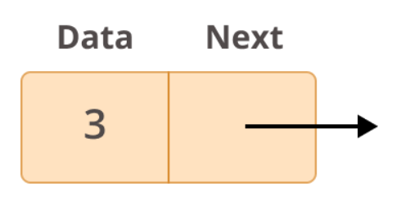
LINKED LIST
A Linked List is a linear data structure. They are a sequence of data, connected together by links or pointers.
Linked Lists are a chain of nodes, connected together by links. Every node (fundamental block of a linked list) contains the following fields:
Data -> The item to be stored in the node.
Next -> The link or reference to the next node.

Slide 5
USES OF LINKED LIST
Due to their dynamic size allocation and ease of insertion/deletion, linked lists are applied in a lot of use cases.
They’re used to implement a lot of complex data structures like the adjacency list in graphs.
They are used for lifecycle management in operating systems.
A playlist in a music application is implemented using a doubly linked list.
Blockchain, a complex data structure that is used for cryptocurrencies and ledgers use a linked list at their core.

Slide 6
LINKED LIST OPERATIONS
There are various linked list operations that allow us to perform different actions on linked lists. For example, the insertion operation adds a new element to the linked list.
Here's a list of basic linked list operations,
Traversal - access each element of the linked list
Insertion - adds a new element to the linked list
Deletion - removes the existing elements
Search - find a node in the linked list
Sort - sort the nodes of the linked list

Slide 7
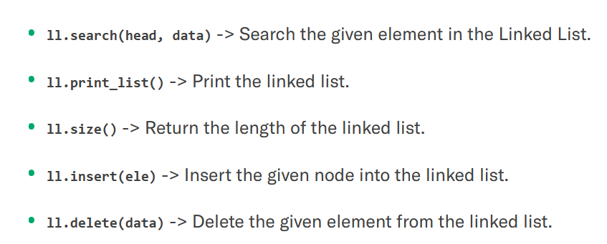
SINGLY LINKED LIST
In the following example, we’ll implement a singly linked list from scratch in Python. This contains the following methods:

Slide 8
Basic operations on Linked Lists:
Deletion

Slide 9
Insertion

Slide 10
Traverse
Traversal of a Linked List
In the previous program, we created a simple linked list with three nodes. Let us traverse the created list and print the data of each node. For traversal, let us write a general-purpose function printList() that prints any given list.

Slide 11
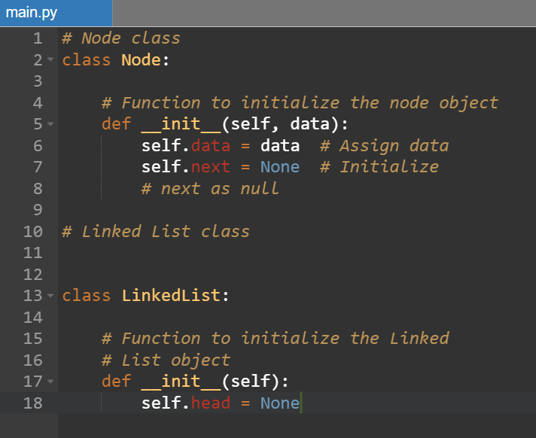
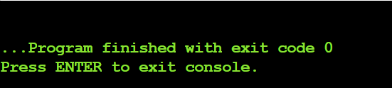
Node creation using singly linked list

Slide 12
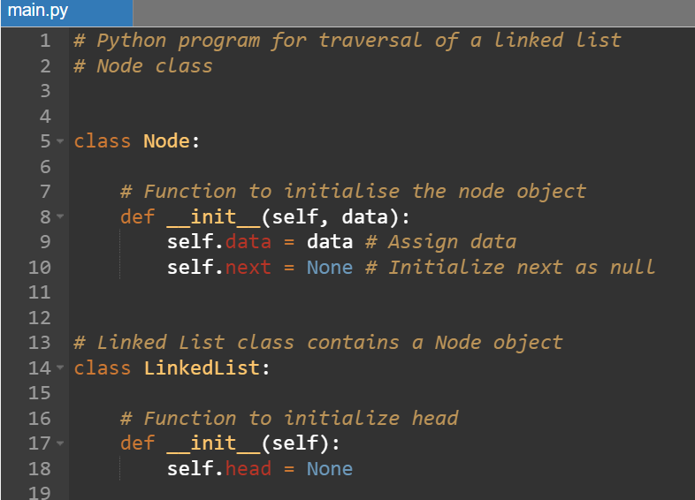
Python program for traversal of a linked list

Slide 13
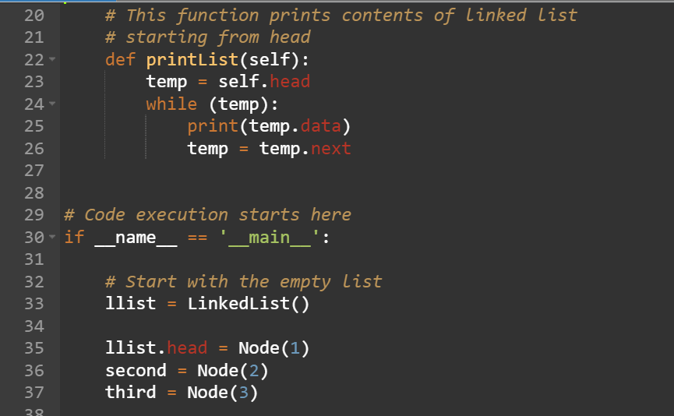

Slide 14
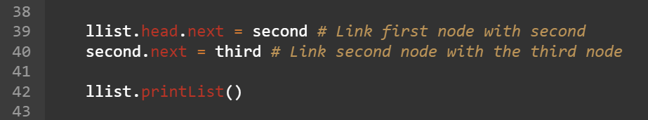
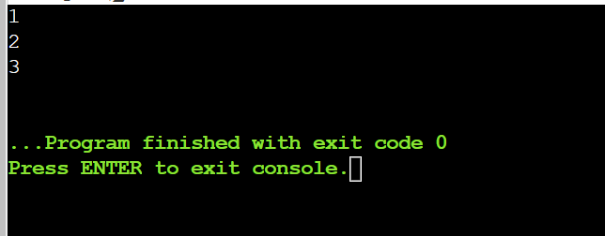
OUTPUT

Slide 15
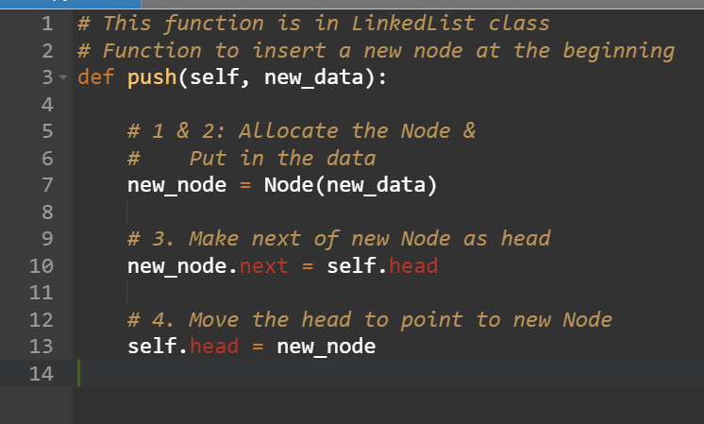
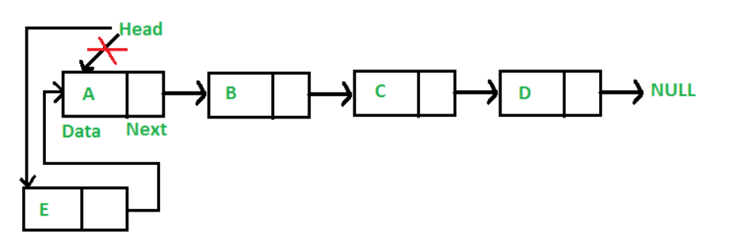
Insertion in Linked List
a. Add a node at the front:

Slide 16
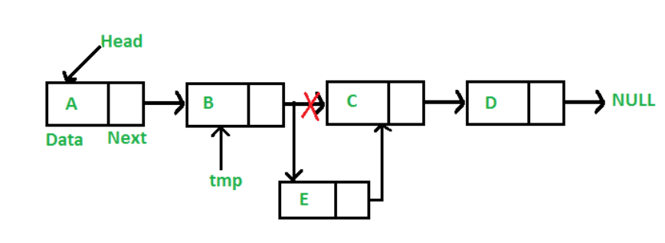
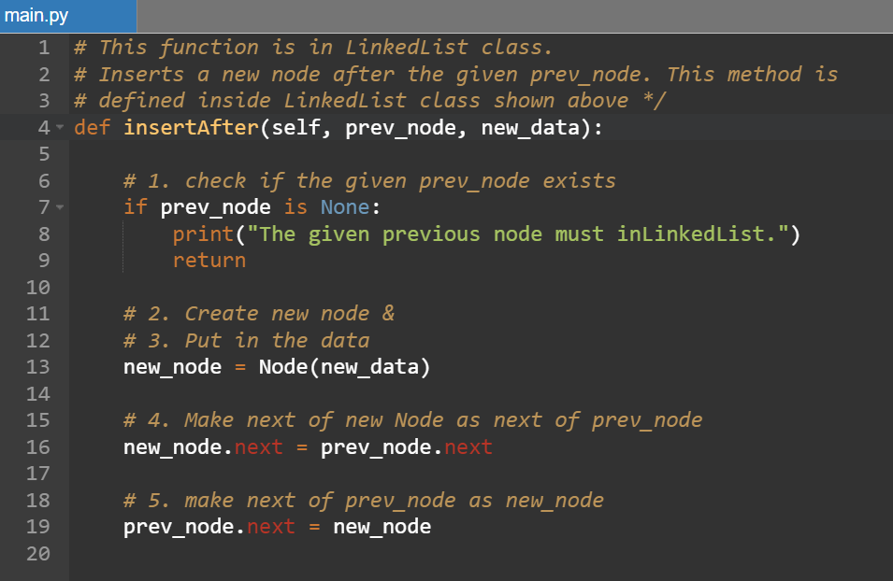
b.Add a node after a given node

Slide 17
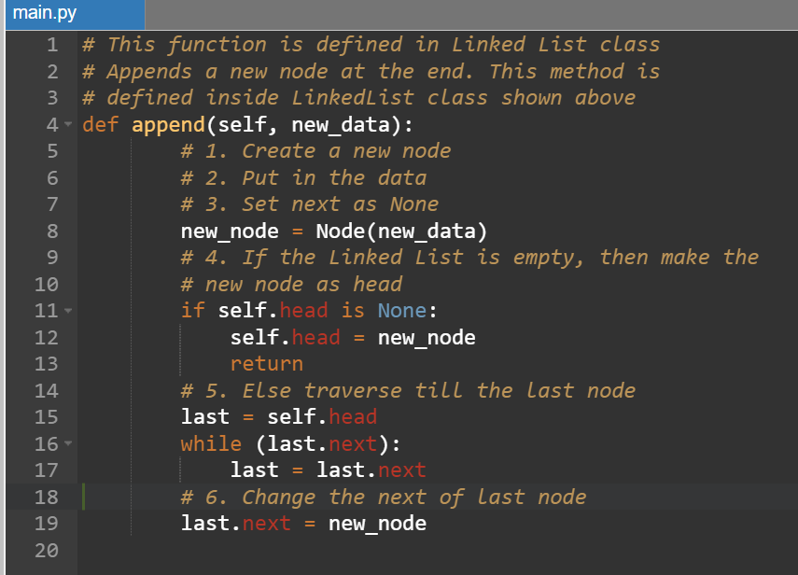
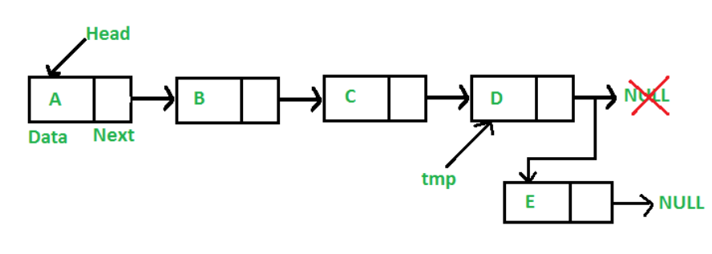
c.Add a node at the end:

